Slide 1
Originale

Slide 2






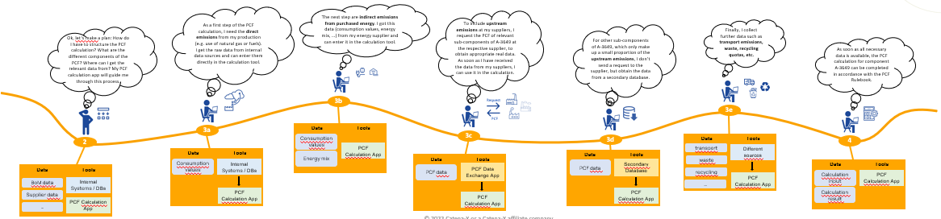
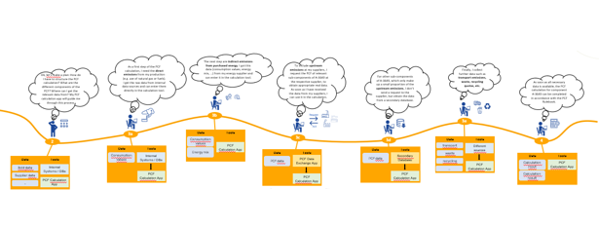
PCF data exchange (overview).
Ah, I received the PCF for component A-3456 from my supplier.
To improve the quality of our sustainability report, I would like to replace the generic PCF for component A-3456 that I have used so far with the real PCF.
To get the real PCF, I send a PCF request to my supplier for component A-3456.
Finally, I transfer the calculation result to the Data Exchange Tool and transfer the data to my customer as a PCF response. So I have answered his PCF request, the job is done.
I transfer the PCF in my internal databases, and now I can use it for my own calculations.
Response
Ah, I received a PCF Request for part A-3456 from my customer.
Request
Customer Journey „PCF calculation“
PCF Controller @ OEM
PCF Controller @ OEM
5
6
1
2
PCF Request
PCF Response
PCF Controller @ tier-1 supplier
Data
Tools
PCF Data Exchange App
Data
Tools
Data
Tools
4
PCF Response
PCF data
PCF Data Exchange App
Data
Tools
3
PCF data
Sustainability Data System
PCF Request
PCF Data Exchange App
Data
Tools
PCF Calculation App
Data
Tools
PCF data
PCF Calculation App
PCF Request
PCF Data Exchange App
Sustainability Data System
PCF Data Exchange App
can cascade along the complete tier-n supply chain
…

Slide 3













PCF calculation(overview).
Ah, I received a PCF Request for part A-3649 from my customer.
As a first step of the PCF calculation, I need the direct emissions from my production (e.g. use of natural gas or fuels). I get the raw data from internal data sources and can enter them directly in the calculation tool.
The next step are indirect emissions from purchased energy. I got this data (consumption values, energy mix, …) from my energy supplier and can enter it in the calculation tool.
Finally, I transfer the calculation result to the Data Exchange Tool and transfer the data to my customer as a PCF response. So I have answered his PCF request, the job is done.
To include upstream emissions at my suppliers, I request the PCF of relevant sub-components of A-3649 at the respective supplier, to obtain appropriate real data.
As soon as I have received the data from my suppliers, I can use it in the calculation.
For other sub-components of A-3649, which only make up a small proportion of the upstream emissions, I don’t send a request to the supplier, but obtain the data from a secondary database.
Finally, I collect further data such as transport emissions, waste, recycling quotas, etc.
Ok, let‘s make a plan: How do I have to structure the PCF calculation? What are the different components of the PCF? Where can I get the relevant data from? My PCF calculation app will guide me through this process.
As soon as all necessary data is available, the PCF calculation for component A-3649 can be completed in accordance with the PCF Rulebook.
PCF Controller @ n-tier supplier
PCF Request
1
Data
Tools
3b
Request
PCF Response
Incoming PCF Request
PCF Data Exchange App
3e
PCF
5
3a
Data
Tools
Consumption values
3c
3d
Data
Tools
4
2
Data
Tools
Data
Tools
PCF Calculation App
transport
Different sources
Energy mix
Data
Tools
Data
Tools
PCF data
PCF Calculation App
Consumption values
Internal Systems / DBs
PCF data
Secondary Database
waste
Data
Tools
Data
Tools
PCF data
PCF Data Exchange App
recycling
PCF Calculation App
Calculation input
PCF Calculation App
BoM data
Internal Systems / DBs
…
PCF Data Exchange App
Supplier data
PCF Calculation App
PCF Calculation App
PCF Calculation App
Calculation result
…
PCF Calculation App

Slide 4
PCF KIT Version (weißer Hintergrund)

Slide 5
PCF data exchange (overview).
Ah, I received the PCF for component A-3456 from my supplier.
To improve the quality of our sustainability report, I would like to replace the generic PCF for component A-3456 that I have used so far with the real PCF.
To get the real PCF, I send a PCF request to my supplier for component A-3456.
Finally, I transfer the calculation result to the Data Exchange Tool and transfer the data to my customer as a PCF response. So I have answered his PCF request, the job is done.
I transfer the PCF in my internal databases, and now I can use it for my own calculations.
Response
Ah, I received a PCF Request for part A-3456 from my customer.
Request
Customer Journey „PCF calculation“
PCF Controller @ OEM
PCF Controller @ OEM
5
6
1
2
PCF Request
PCF Response
PCF Controller @ tier-1 supplier
Data
Tools
PCF Data Exchange App
Data
Tools
Data
Tools
4
PCF Response
PCF data
PCF Data Exchange App
Data
Tools
3
PCF data
Sustainability Data System
PCF Request
PCF Data Exchange App
Data
Tools
PCF Calculation App
Data
Tools
PCF data
PCF Calculation App
PCF Request
PCF Data Exchange App
Sustainability Data System
PCF Data Exchange App
can cascade along the complete tier-n supply chain
…

Slide 6
PCF calculation(overview).
Ah, I received a PCF Request for part A-3649 from my customer.
As a first step of the PCF calculation, I need the direct emissions from my production (e.g. use of natural gas or fuels). I get the raw data from internal data sources and can enter them directly in the calculation tool.
The next step are indirect emissions from purchased energy. I got this data (consumption values, energy mix, …) from my energy supplier and can enter it in the calculation tool.
Finally, I transfer the calculation result to the Data Exchange Tool and transfer the data to my customer as a PCF response. So I have answered his PCF request, the job is done.
To include upstream emissions at my suppliers, I request the PCF of relevant sub-components of A-3649 at the respective supplier, to obtain appropriate real data.
As soon as I have received the data from my suppliers, I can use it in the calculation.
For other sub-components of A-3649, which only make up a small proportion of the upstream emissions, I don’t send a request to the supplier, but obtain the data from a secondary database.
Finally, I collect further data such as transport emissions, waste, recycling quotas, etc.
Ok, let‘s make a plan: How do I have to structure the PCF calculation? What are the different components of the PCF? Where can I get the relevant data from? My PCF calculation app will guide me through this process.
As soon as all necessary data is available, the PCF calculation for component A-3649 can be completed in accordance with the PCF Rulebook.
PCF Controller @ n-tier supplier
PCF Request
1
Data
Tools
3b
Request
PCF Response
Incoming PCF Request
PCF Data Exchange App
3e
PCF
5
3a
Data
Tools
Consumption values
3c
3d
Data
Tools
4
2
Data
Tools
Data
Tools
PCF Calculation App
transport
Different sources
Energy mix
Data
Tools
Data
Tools
PCF data
PCF Calculation App
Consumption values
Internal Systems / DBs
PCF data
Secondary Database
waste
Data
Tools
Data
Tools
PCF data
PCF Data Exchange App
recycling
PCF Calculation App
Calculation input
PCF Calculation App
BoM data
Internal Systems / DBs
…
PCF Data Exchange App
Supplier data
PCF Calculation App
PCF Calculation App
PCF Calculation App
Calculation result
…
PCF Calculation App

Slide 7
PCF KIT Version (schwarzer Hintergrund)
Habe es ausprobiert, es sieht nicht gut aus …

